Slide 1
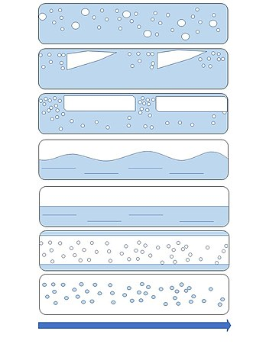
MID TERM REPORT
Intro to Multiphase flow

Slide 2
What is Mutiphase Flow?
Multiphase flow refers to the simultaneous flow of more than one fluid phase.
Phase: A region of matter with uniform physical and chemical properties.
Surface tension: Force per unit length at the interface of two immiscible phases, acting perpendicular to the interface.
Interface: The boundary between two phases.
Wetting: The ability of a liquid to spread over or adhere to a solid surface.
Multiphase: A system consisting of two or more phases.

Slide 3
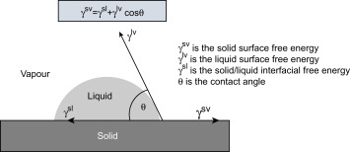
Continuum approximation: The substance of the fluid is distributed evenly and fills completely the space it occupies. At each point of the region of the fluid it is possible to construct one volume small enough compared to the region of the fluid and still big enough compared to the molecular mean free path.
Contact Angle (hydrophobic and hydrophilic surfaces): The angle formed between the tangent to the liquid-solid interface and the solid surface.
Electrowetting: The change in contact angle induced by an electric field applied to the liquid-solid interface.
Young's Law for the contact angle: The relationship between the contact angle, surface tension, and interfacial energy of a liquid-solid interface.

Slide 4
Assignment-1
Identify whether interfaces exist or not in the following systems: carbonated cold drinks, oil and water, milk and water, Ethanol and water. Water at critical point.

Slide 5
Carbonated cold drinks: Interfaces exist between the liquid and gas phases of the carbon dioxide dissolved in the drink.
Oil and water: Interfaces exist between the immiscible oil and water phases.
Milk and water: Interfaces exist between the milk and water phases, as milk is an emulsion of fat droplets dispersed in a water-based solution.
Ethanol and water: Interfaces exist between the immiscible ethanol and water phases.
Water at critical point: At the critical point, there is no distinction between the liquid and gas phases, so there are no interfaces between them.

Slide 6

Laminar flow: Smooth, orderly flow in which fluid particles move in parallel layers, without significant mixing between them.
Turbulent flow: Irregular flow characterized by random fluctuations and mixing of fluid particles.
Different flow regimes in multiphase flow: The different patterns of flow that can occur when two or more phases are present, such as stratified flow, bubbly flow, slug flow, annular flow, and mist flow. These regimes are determined by the relative velocities, volumes, and physical properties of the phases.
Hagen poiseuille equation:
u: velocity of fluid
r: radial distance from the centre
μ: viscosity
dp/dx: pressure drop per unit length of the pipe

Slide 7
Assignment-2
Using MATLAB plots, compare u(r) you got from the analytical solution and the numerical solution
Take
dp/dx=-200N/m3 (as pressure is decreasing with length)
μ=1.25 poise
u(r=0)=1m/s
u(R)=0
R: radius of cylindrical pipe

Slide 8
fileid=fopen("A1input.txt",'r');
format= '%f';
array = fscanf(fileid,format);
meu=array(1);
pg=array(2);
deltar= array(3);
R = array(4);
n=R/deltar;
n=n+1;
U=ones(n,1);
U(1)=1;
UR=ones(n,1);
UR(1)=1;
r=zeros(n,1);
r(1)=0;
for i=2:n
r(i)=r(i-1)+deltar;
UR(i)=1-(r(i)/R)*(r(i)/R);
end
mm=pg*10/(2*meu);
for i=2:n
U(i)=U(i-1)+deltar*mm*r(i-1);
r(i)=r(i-1)+deltar;
end
fileid=fopen('MF_A1_O.txt','w');
fprintf(fileid,'r(m) U(m/s) U(num)(m/s)\n');
for i=1:n
fprintf(fileid,'%f %f %f\n',r(i,1),U(i,1),UR(i,1));
end
plot(r,UR,'r^','Markersize',2,'Linewidth', 2)
line(r,U)
hold on
plot(r,U,'b^','Markersize',2,'Linewidth', 2)
line(r,UR)
legend('Numerical Soln','Analytical Soln');
grid on
xlabel("Distance from centre(m)");
ylabel("Velocity(m/s)");
str = sprintf('For r= %0.3f', deltar);
title(str)

Slide 9
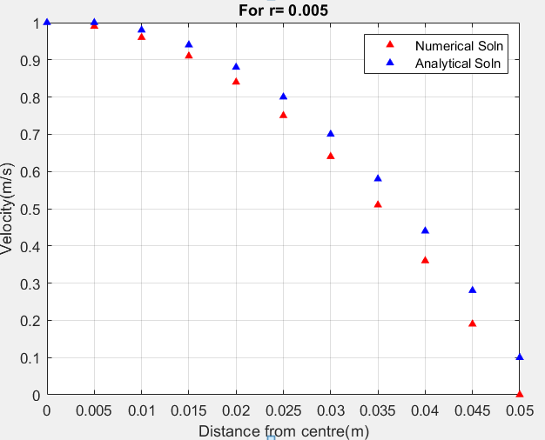

Slide 10
Heat: Energy that is transferred between two objects due to a temperature difference.
Heat flow: The transfer of heat from a high-temperature object to a low-temperature object.
Modes of heat transfer: Conduction, convection, and radiation.
Conduction heat flow formula: Q = kA (T2 - T1)/L, where Q is the heat flow rate, k is the thermal conductivity, A is the cross-sectional area, T1 and T2 are the temperatures at the two ends of the object, and L is the length of the object.
Convection heat flow formula: Q = hA(Ts - T∞), where Q is the heat flow rate, h is the convective heat transfer coefficient, A is the surface area, Ts is the surface temperature, and T∞ is the temperature of the fluid.
Radiation heat flow formula: Q = σA(Ts^4 - T∞^4), where Q is the heat flow rate, σ is the Stefan-Boltzmann constant, A is the surface area, Ts is the surface temperature, and T∞ is the temperature of the surroundings.
Thermal resistance circuital analogy: R = L/kA, where R is the thermal resistance, L is the length of the object, k is the thermal conductivity, and A is the cross-sectional area.
Fourier’s Law of heat conduction: q = -k∇T, where q is the heat flux, k is the thermal conductivity, and ∇T is the temperature gradient.

Slide 11
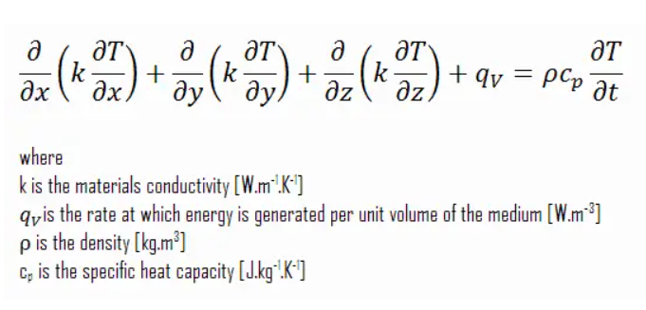
Heat Conduction Equation:
Cartesian Coordinate

Slide 12
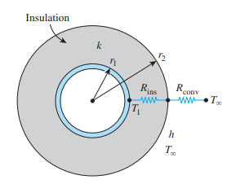
Assignment-3
Consider a cylindrical pipe of outer radius r1 whose outer surface temperature T1 is maintained constant (Fig. 3–30). The pipe is now insulated with a material whose thermal conductivity is k and outer radius is r2. Heat is lost from the pipe to the surrounding medium at temperature T`, with a convection heat transfer coefficient h. Plot Q(heat transfer) vs r for the sphere.

Slide 13
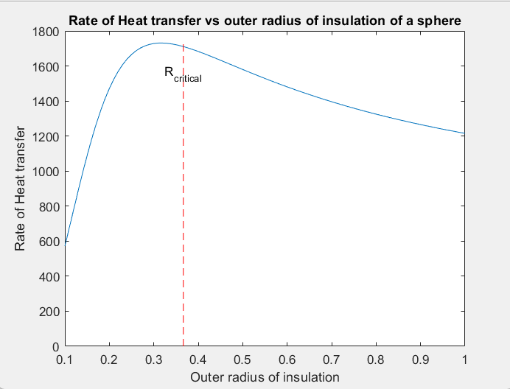
r1 = input("inner radius of the sphere ");
r=input("outer radius of insulated sphere ");
T1 = input("temperature of inner surface ");
Tinf = input("temperature of surroundings ");
k = input("thermal conductivity of insulation ");
h = input("convective heat transfer coefficient ");
r2_vec = r1:0.01:r;
r=h/k;
Q_vec = zeros(size(r2_vec));
for i = 1:length(r2_vec)
r2 = r2_vec(i);
A = 4*pi*r2^2;
R_cond = log(r2/r1)/(2*pi*k);
R_conv = 1/(h*A);
R_total = R_cond + R_conv;
Q = (T1-Tinf)/R_total;
Q_vec(i) = Q;
end
plot(r2_vec, Q_vec)
line([R_critical, R_critical], [0, max(Q_vec)], 'LineStyle', '--', 'Color', 'r');
text(R_critical, 0.9*max(Q_vec), 'R_{critical}', 'HorizontalAlignment', 'center')
hold off
xlabel('Outer radius of insulation')
ylabel('Rate of Heat transfer')
title('Rate of Heat transfer vs outer radius of insulation of a sphere')

Slide 14
End of Report ThankYou
Prerna Singh Chauhan 210767

